Slide 1
Family Medical Center of MI, Inc.
School-Based Behavioral Health:
Increasing Access to Care in Rural Michigan

Slide 2
Agenda
About us
Identified Need for School-Based BH Services
Getting Started
From Grant Project to Sustainable Program
From a Providers Perspective
Expansion and Growth

Slide 3
About Us
Family Medical Center of MI (FMC) is a not-for-profit Community Health Center offering a range of healthcare services in Monroe, Lenawee and Wayne Counties.
FMC serves all patients regardless of their ability to pay and offers discounted payment arrangements for patients with no insurance.
FMC is the largest provider of services to patients in the communities we serve with Medicaid and Healthy Michigan insurance. FMC also accepts Medicare, most private insurance plans.
FMC is also a federally designated migrant health center.

Slide 4

Family Medical Center of MI
Mission: Family Medical Center of MI is dedicated to quality and excellence in providing integrated, comprehensive and cost effective medical and dental health care to all regardless of their ability to pay.

Slide 5
Services
Primary Care
Behavioral Health and Psychiatry
Office based
School-based
Telehealth
Dentistry
Medication Assisted Treatment
Substance Use Disorder Treatment

Slide 6
FMC’s Patient Population
~19,000 unique patients
PC ~13,000
BH ~3000
School based ~400
Dental ~ 6000
MAT/SUD ~300
~ 70,000 annual visits
55 - 60% Medicaid and Healthy Michigan
8 -10% Uninsured
Majority Adult population (18-65)

Slide 7
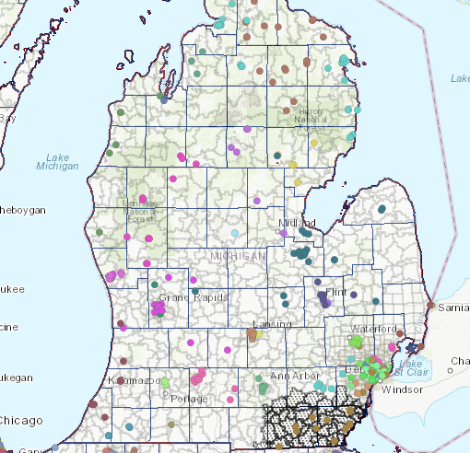
FMC Service Area

Slide 8

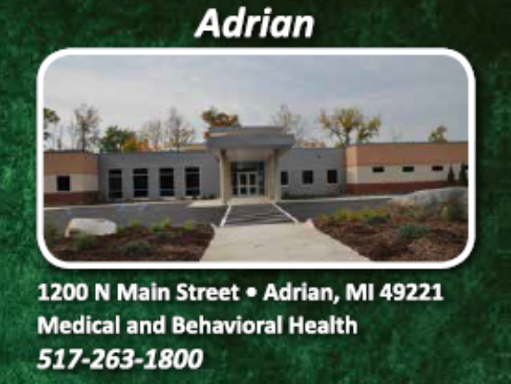

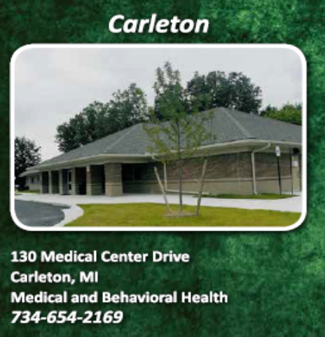

Locations

Slide 9
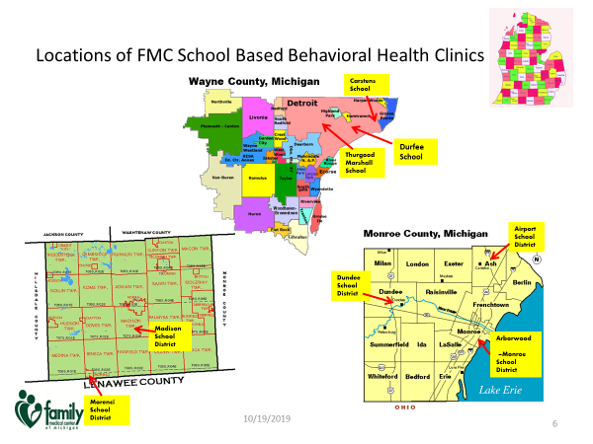

Slide 10
FMC’s Long History of Collaboration
Safety Net Organizations
Community Mental Health
Local Health Departments
Social Services Organizations
Department of Health and Human Services
Hospital Systems
Community-Based Providers
Schools

Slide 11
Recognizing Unmet Behavioral Health Need in the Service Area

Slide 12
Need
It is estimated that between 2% and 13% of US children have some type of mental health condition, many of which go undiagnosed and/or untreated.
Undiagnosed and untreated mental health disorders among children can result in
poor school performance
absenteeism
poor conflict resolution
family trouble
violence
suicide

Slide 13
Substance abuse disorders are also a major concern among children and adolescents, particularly among those with undiagnosed or untreated underlying mental health issues
16% of high school students in Michigan reported trying alcohol for this first time before age thirteen.
18% reported binge drinking in the last 30 days as defined by five or more drinks over a couple of hours.
35% reported having ever used marijuana
10% reported having ever used inhalants and 6% reported using non-prescription pain killers in the past year

Slide 14
Behavioral Health Concerns in Youth
The most frequently identified behavioral health issues among children and adolescents include:
Adjustment Disorders
Anxiety
Attention Deficit Hyperactivity Disorder (ADHD)
Depression
Post-Traumatic Stress Disorder (PTSD)

Slide 15
A Funding Opportunity:
Michigan Health Endowment Fund

Slide 16
Initial School-based Behavioral Health Project
In 2016, FMC applied for and was awarded $479,881 Grant from the Michigan Health Endowment Fund to launch the School Based Telehealth in Rural Communities Project
The goal of the project was to IMPROVE ACCESS to behavioral health services for school-aged children via telemedicine and onsite services in partnership with local school districts.

Slide 17
Selecting Pilot Schools by Using Free and Reduced Lunch as Proxy for Need

Slide 18
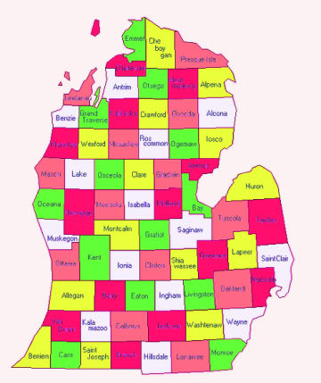
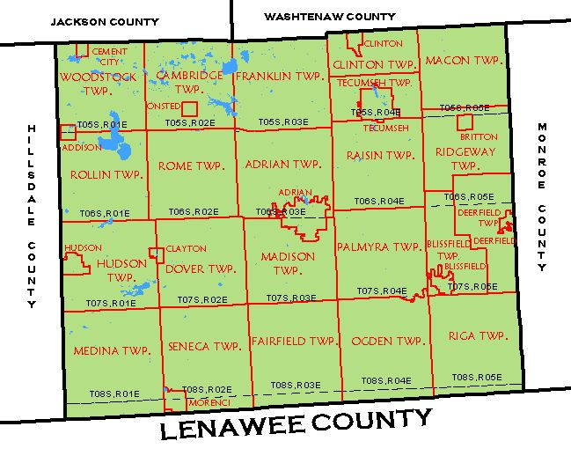
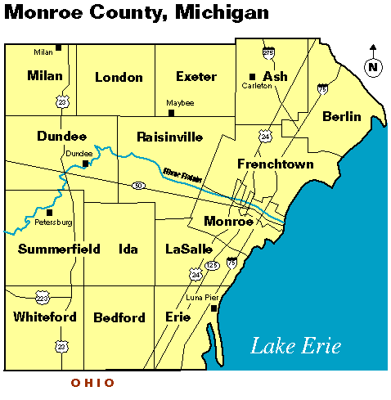
Locations of Initial School Based Behavioral Health Clinics
Airport School District
Britton School District
Deerfield School District
Dundee School District
Madison School District
Arborwood –Monroe School District
Morenci School District

Slide 19
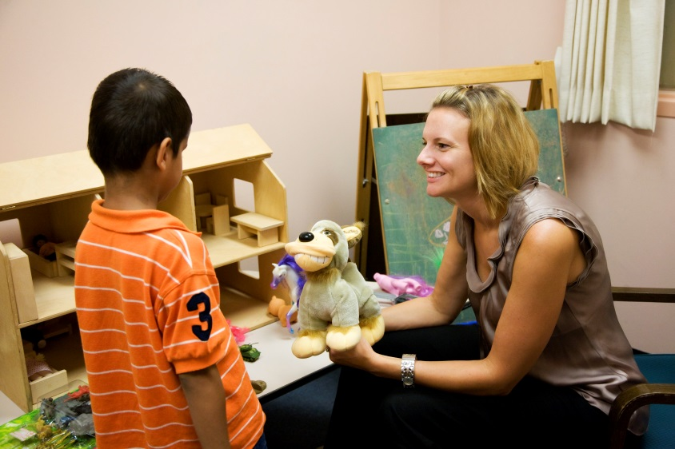
The proposed School-Based Behavioral Health Services Model
Student remains in school for in-person behavioral health services
Behavioral Health Specialists come to
the school to provide services including:
Biopsychosocial Assessment
Psychological evaluation and testing
Individual therapy
Identification of additional resources
Coordination and management of care

Slide 20
Expected Health Outcomes of Grant
By the end of the 2016-17 school year, participating students would exhibit improved health status as measured by improvement on behavioral health assessments for depression, anxiety, and substance use disorders
By the end of the 2016-2017 school year, reduction in self-reported substance use among participating students
Data was to be measured using individual longitudinal patient data.

Slide 21

Anticipated Long Term Impacts (3-5 years)
Improved graduation rates in participating schools
Reduced suspensions among students in participating schools
Reduced absenteeism among students at participating schools
Improved grades/test scores among students at participating schools
Data was to be measured using aggregated MI School Data for participating schools

Slide 22
Results of Grant Effort
During the course of the two-year grant period, FMC successfully engaged six school districts throughout the service area and in two counties
Four Behavioral Health Specialists and two Support Coordinators staffed the program and one telepsychiatrist
738 number of children were actively receiving services and initial indication of student health improvement was positive
Very high rates of school staff and administration satisfaction
FMC was able to transition the program to a self-sustaining, reimbursement-based service

Slide 23
Beyond the Grant Period
After the grant ended, FMC continued activities:
Engaging Schools
Educating School Staff
Monitoring success
Financial Sustainability

Slide 24
School-Based Telemedicine and Behavioral Health Services

Slide 25

School-Based Telemedicine Services How does it work?

Slide 26
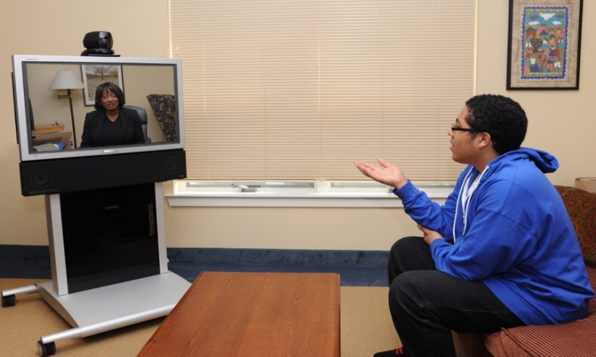
Student remains in school for “virtual” visit with psychiatrist
A Behavioral Health Specialist or Support Coordinator onsite at the school will facilitate the visit

Slide 27
Psychiatrist located in remote Family Medical Center of MI medical clinic provides clinical assessment, treatment plan, and is able to prescribe medication
Parent or guardian comes to the school to attend the psychiatry appointments with the student

Slide 28
How to Make a Referral
1. Designated person at the school will contact the parent or legal guardian to inform them of the referral
2. Send paperwork packet home for parent to review, complete, and bring to their first appointment
Explanation of services
Consents
Insurance information form
3. Complete Referral
Paper Form
Google Doc form

Slide 29
School-Based Behavioral Health Services
Student remains in school for in-person behavioral health services
Parent or guardian:
Comes to the school for the Biopsychosocial Assessment
Sign consent forms
Do not need to be present for follow up appointments

Slide 30
Behavioral Health Specialist’s office is located at the school to provide the following services:
Biopsychosocial Assessments
Individual Therapy
Group Therapy
Family Therapy
Screenings of students
Identification of community resources
Coordination and management of care

Slide 31
The Benefits
Timely and increased access to healthcare
Early identification and intervention
Convenience for those with transportation difficulties
Less time away from work for parents and school for students
Increased teacher and school collaboration with behavioral health providers
Increased likelihood of improved attendance, better grades, and fewer classroom disruptions

Slide 32
The Team
Telepsychiatrist, Monroe, Lenawee, and Wayne Counties:
Mubeen A. Memon, MD
Severia Adolpus, Psychiatric NP
Behavioral Health Specialists, Lenawee Co:
Kelly Swett, MA, LLPC
Alexa Anderson, MA, LLPC

Slide 33
The Team
Behavioral Health Specialists, Monroe Co:
Meredith Gilliam, LMSW
Austin Kovar, MA, LLP
Kailah Ayres-Tuttle, MA, LLPC
Corinne Howe, LLMSW
Candace Kovar, MA, TLLP
Behavioral Health Specialists, Wayne Co:
Kierra Jones, LLMSW
Monica Rich-McLaurin, LMSW

Slide 34
The Team
Program Support Coordinator, Monroe Co:
Shannon Lorentz
CMA – In process of hiring
Program Medical Support Coordinator, Wayne Co:
Shachara Pullen, CMA
Program Medical Support Coordinator, Lenawee Co:
M’Chae Hollowell, CMA

Slide 35

“Normal” behavior?
It can be difficult to discern the difference between “normal” child and adolescent changes in behavior due to hormones, physical changes, and the significant social adjustments they are dealing with, versus a more serious issue.

Slide 36
Signs a child or adolescent may be struggling:
Decrease in enjoyment and time spent with friends and family (isolation)
Significant decrease in school performance
Loss of interest in sports or activities they used to enjoy
A change in sleep habits/rituals
Strong resistance to attending school or absenteeism
Problems with memory, attention or concentration
Significant changes in energy levels or eating (weight gain or weight loss)
Physical symptoms (stomachaches, headaches, backaches, etc) and/or frequent visits to the school nurse

Slide 37
Signs a child or adolescent may be struggling:
Feelings of hopelessness, sadness, anxiety, crying often
Frequent aggression, disobedience or lashing out verbally
Excessive neglect of personal appearance or hygiene
Substance use
Dangerous, illegal, or thrill-seeking behavior
Making critical comments about themselves, behavior problems at school or at home
Signs of cutting, burning or other self-harm
Preoccupation with death

Slide 38
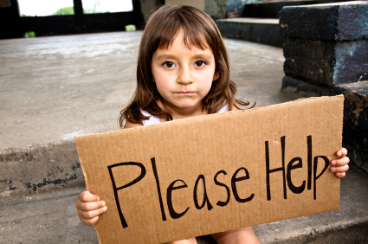
Students Reaching Out
If a young person reaches out for help NEVER dismiss it as attention seeking behavior. Usually by the time they reach out (if they do), they really need help
If you are ever in doubt, always err on the side of caution
Many sign/symptoms are also indicative of normal behavior and require professional diagnosis

Slide 39
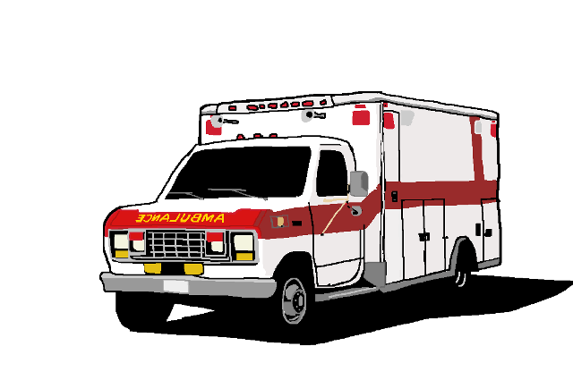
Crisis Response Needed?
If a student in this program demonstrates intentions of suicide or is in immediate crisis while at school, each school will utilize their crisis intervention protocol

Slide 40
School-Based Services
Service | Telemedicine | School-Based Assessment | School-Based Testing | School-Based Therapy
Delivery Model | Video Conferencing at school | Students will meet with a FMC behavioral health specialist in-person at the school
Description of Service | Students will be able to meet with a psychiatrist at FMC, face-to-face, via a video call that is facilitated by an onsite behavioral health specialist and get appropriate medications prescribed | Students will be assessed to evaluate the concerns related to the child and determine the appropriate services and interventions needed | Students will be tested if needed for childhood diagnoses, such as ADHD, Oppositional Defiant Disorder, and Conduct Disorder | Student will receive individualized therapy to develop coping skills and work on symptom and stress management

Slide 41
A School-Based BH Provider’s Experience: Meredith Gilliam, LMSW

Slide 42
Expansion and Growth
Financial sustainability
Billing and reimbursement
Ongoing Expansion
Requests from new schools
Partnership with Community Mental Health and ISD
Word of mouth https://www.youtube.com/watch?v=WAcAcO4jVfw

Slide 43
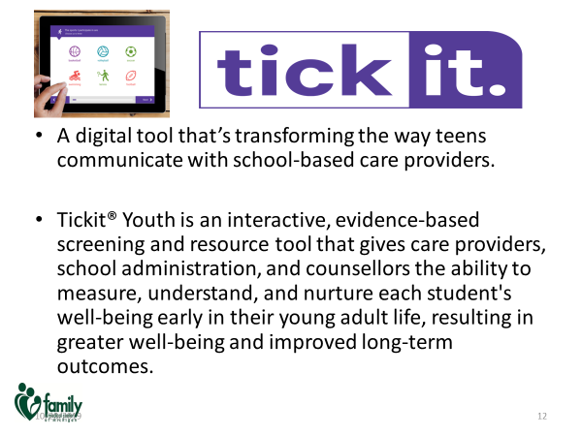
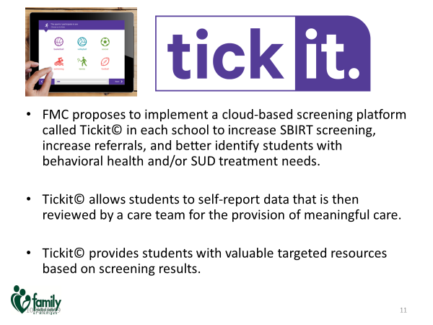
Expanding Services (Cont.)

Slide 44
Ideas for Expanding SBBH Services in your Community
Partner with area FQHC
Collaborate with local ISD
Work with local hospital systems
Provide screening resources to schools and appropriate referrals to treatment

Slide 45
Questions?
Audrey Smith, COO: asmith@familymedical.org
Jessica Parsil, Behavioral Health Director: jparsil@familymedical.org
Meredith Gilliam, BH Consultant: mgilliam@familymedical.org
Jamie Ferguson, VP of Quality: jferguson@familymedical.org

